Slide 1

Automating L1 Security Operations with Agentic AI
Transforming alert triage through intelligent automation and AI-driven investigation workflows

Slide 2

Project Vision and Achievement
Our Goal
What We Achieved
Revolutionize L1 analyst workflows by implementing agentic AI to automate initial alert investigation, reduce analyst workload, and intelligently disambiguate security alerts with actionable recommendations for case conversion.
Successfully deployed an AI-powered investigation system that autonomously processes alerts, correlates threat intelligence, and provides contextualized recommendations with confidence scores.
The system now handles routine investigations while flagging complex scenarios for human review.
The vision was to shift analysts from repetitive triage to high-value security analysis.
01
Alert Ingestion
Automated collection from SIEM and security tools
02
AI Investigation
Contextual analysis using threat intelligence and historical data
03
Disambiguation
Classification with confidence scoring and case recommendation
04
Analyst Review
Human validation of high-priority findings

Slide 3
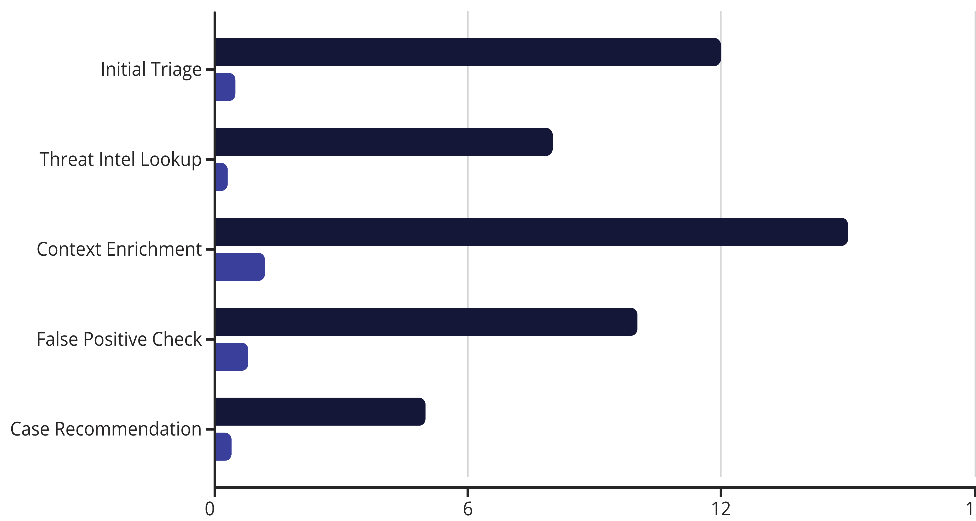
Efficiency Gains: Human vs AI Performance
Comparing time investment across key investigation activities reveals dramatic efficiency improvements through AI automation.
Human Analyst (minutes)
AI System (minutes)
96%
20x
3.2
Time Reduction
Throughput Increase
Minutes per Alert
Average investigation time decreased from 50 minutes to 3 minutes per alert
Analysts can now focus on complex cases while AI handles routine investigations
AI completes full investigation cycle in under 4 minutes with high accuracy

Slide 4
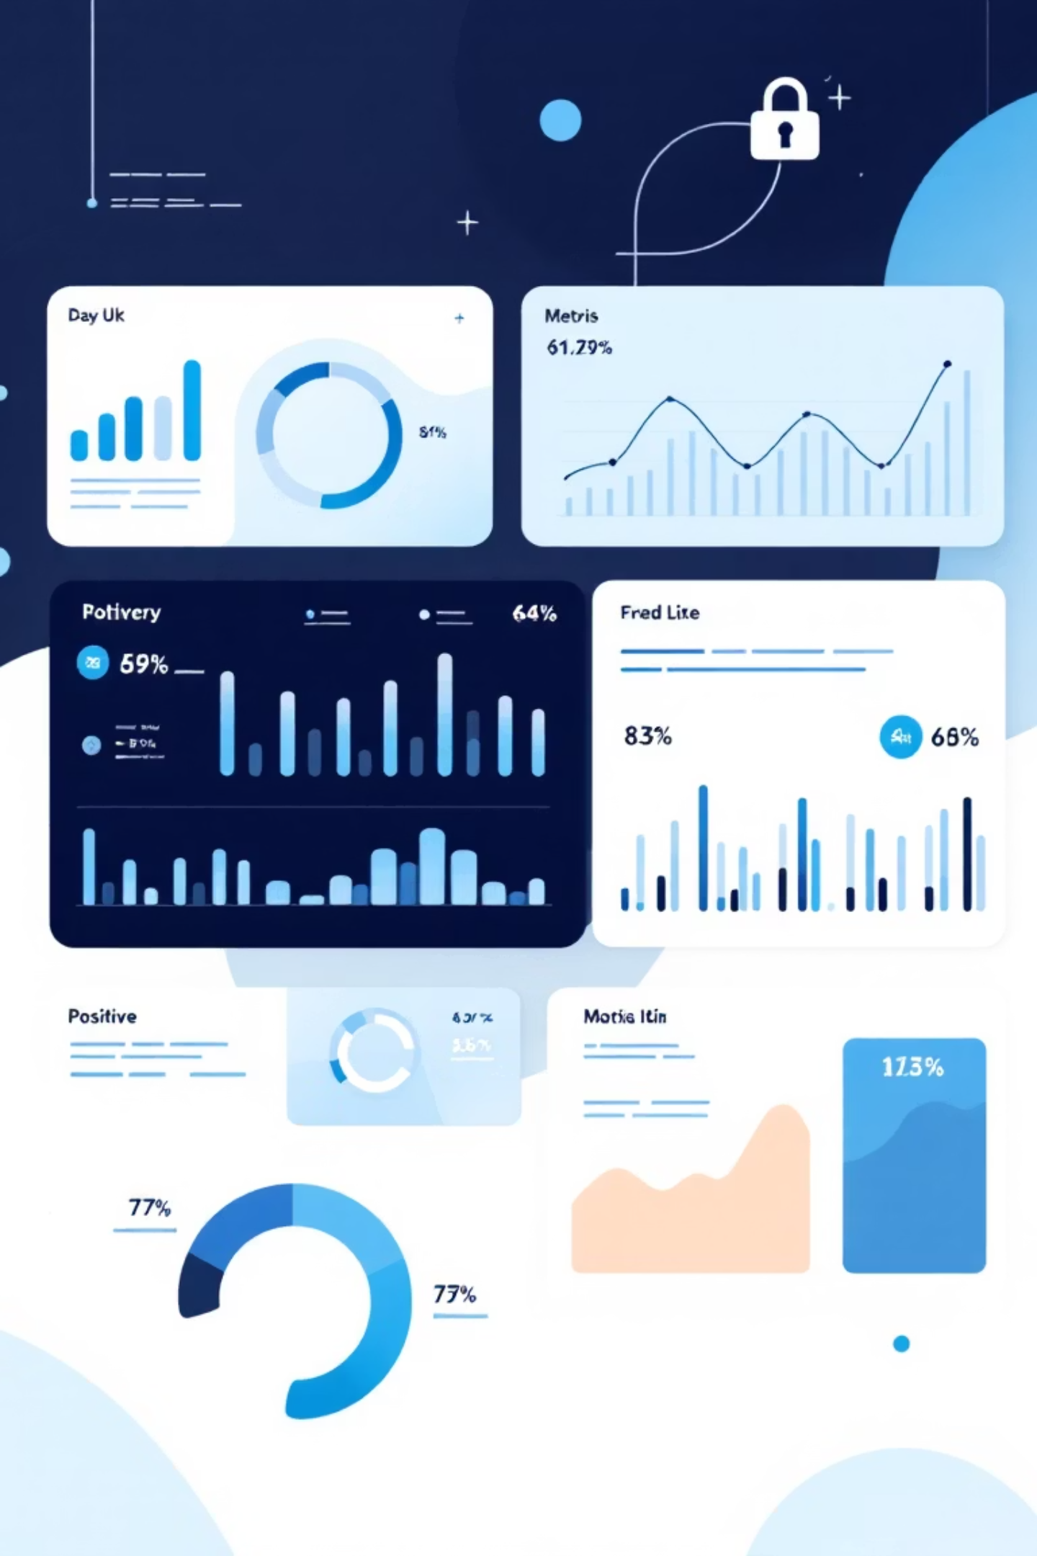
Measurable Outcomes and Impact
Alert Processing Volume
Case Quality Improvement
1,847 alerts processed daily (up from 412)
False positive rate reduced by 67%
89% handled without human intervention
92% recommendation accuracy
Zero missed critical incidents
Analyst satisfaction score: 8.4/10
Resource Optimization
247 analyst hours saved per week
L1 team refocused on threat hunting
Mean time to respond decreased 41%

Slide 5


Current Status and Key Observations
Implementation Status
Production deployment complete across all alert sources with 24/7 monitoring. The AI system is processing live security events with human oversight on high-confidence case recommendations.
Critical Observations
AI excels at pattern recognition and correlation across large alert volumes
Human expertise remains essential for complex threat scenarios and edge cases
Continuous learning improves accuracy by 2-3% monthly as the model adapts
Integration with existing SOAR playbooks enhances response automation
Analyst Feedback
"The AI handles the tedious correlation work, letting us focus on actual threat analysis. It's like having a tireless junior analyst who never sleeps."

Slide 6

Roadmap: Scale and Continuous Improvement
1
Q1 2024: Enhancement Phase
Expand AI capabilities to L2 investigation workflows, add predictive threat modeling, and integrate with threat hunting tools.
2
Q2 2024: Optimization
Fine-tune models based on six months of production data, implement advanced NLP for unstructured log analysis.
3
Ongoing: Feedback Loop
Weekly model retraining with analyst corrections, monthly accuracy audits, and quarterly capability assessments.
Maintenance and Governance
Model Monitoring
Analyst Training
Continuous drift detection, bias checking, and performance metrics tracking with automated alerts
Monthly workshops on AI-assisted workflows, feedback mechanisms, and escalation procedures
Feedback Integration
Analyst corrections feed directly into model retraining pipeline with prioritized learning

